Slide 1
Digitally ready for now and tomorrow

Slide 2
In this session we will look at:
What a relevant website is
Social media & staying active on it
TripAdvisor’s importance and how it relates to DBC
Google listing / Google my Business
Intro to making a website

Slide 3
What year was your website made in?
Your website is the your new storefront - if your website sucks, you are undeniably missing out on business

Slide 4
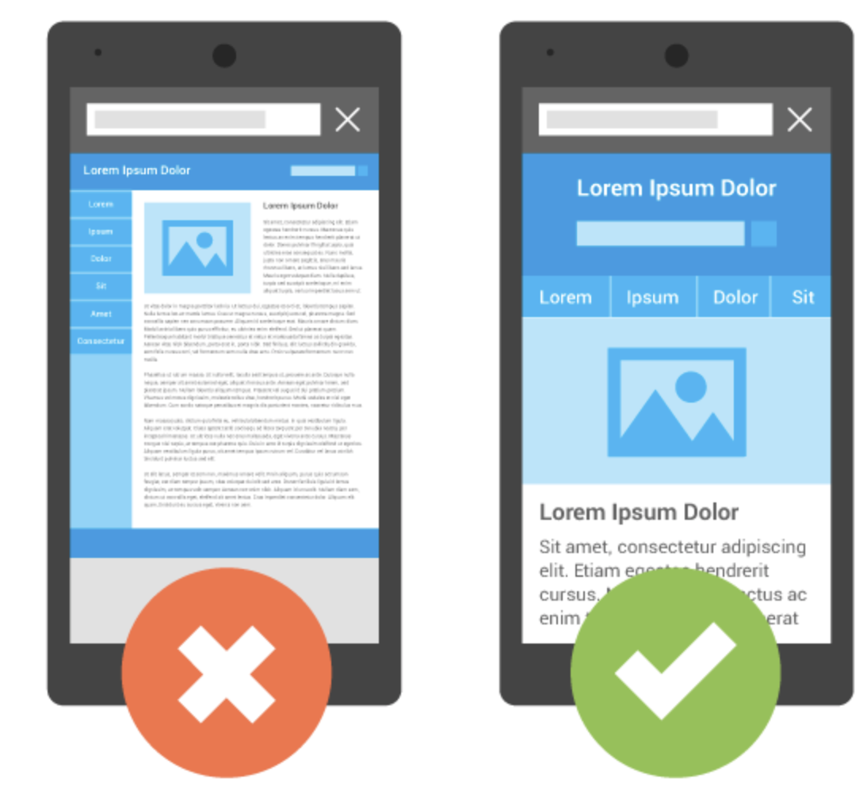
48 percent of users say that if a business’ website is not mobile-friendly, they’ll take it as an indication that the business simply doesn’t care.

Slide 5
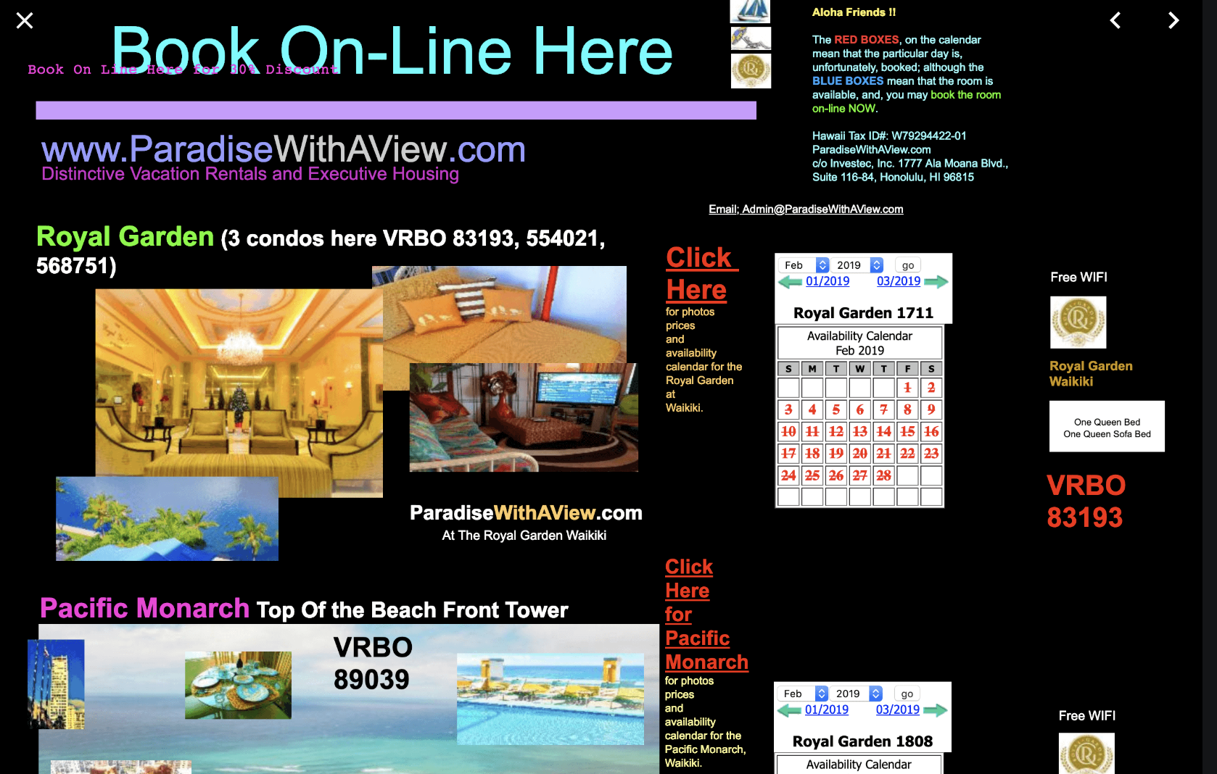
48 percent of people cited that a website’s design is the No. 1 factor in determining the credibility of a business.

Slide 6
38 percent of visitors will stop engaging with a website if the content or layout is unattractive.

Slide 7
62 percent of companies increased their sales by designing responsive mobile platforms for their websites.

Slide 8
40 percent of people will switch to a different search result if the first one is not mobile-friendly

Slide 9
72 percent of people want mobile-friendly websites

Slide 10
Mobile devices now account for nearly two out of every three minutes spent online

Slide 11
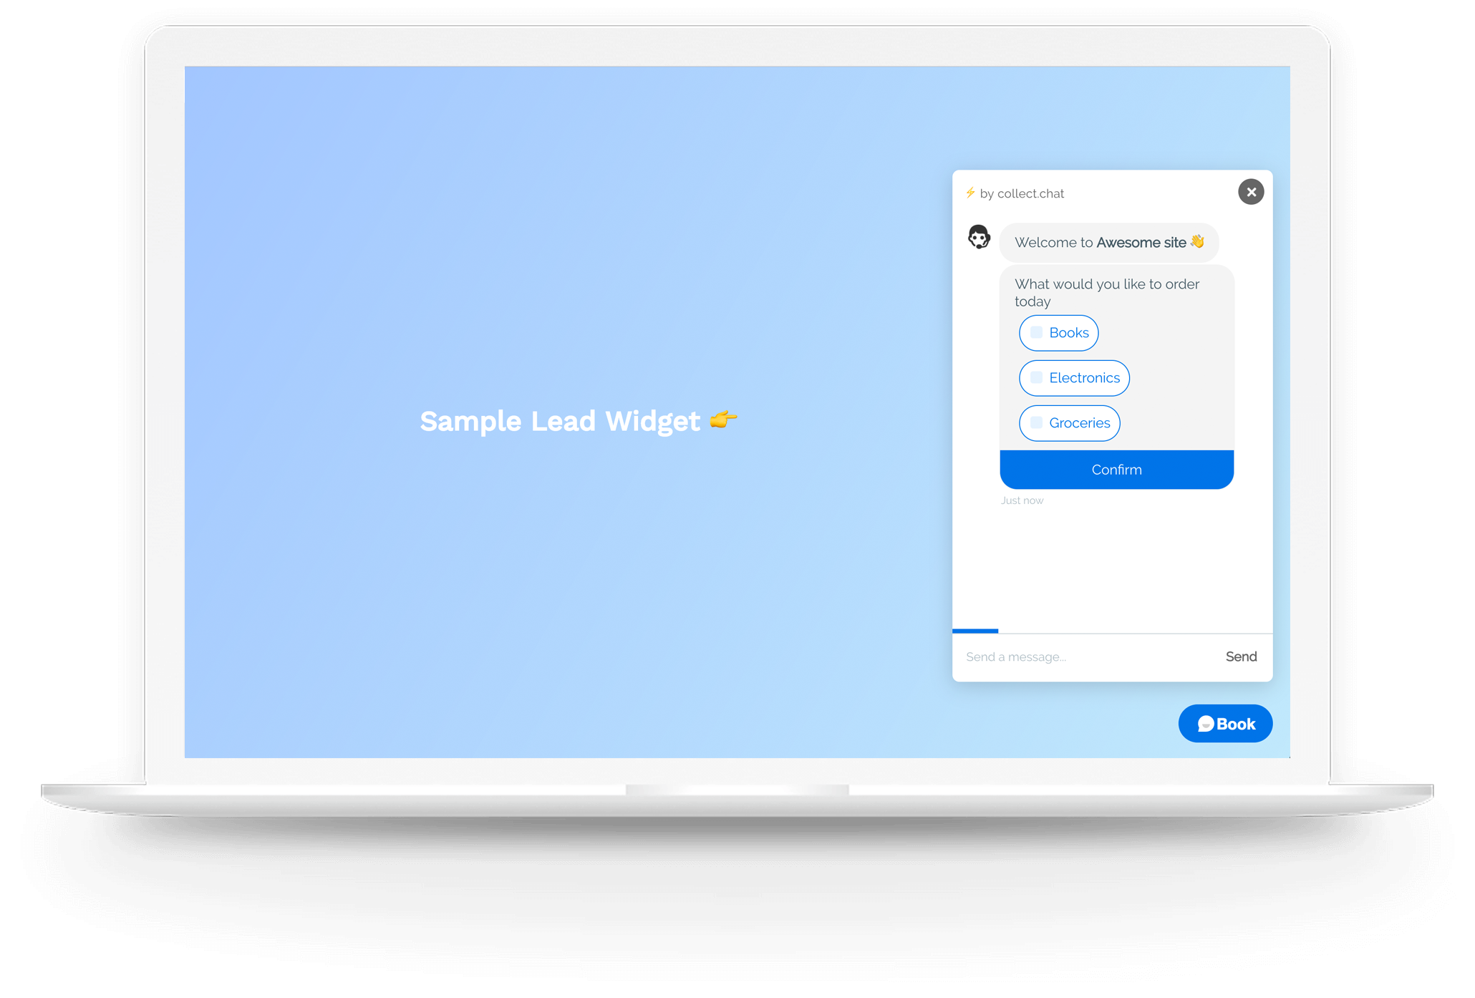
A few tricks to stay relevant…
Chatbots
Notes:
You can get a chatbot plugin on our website and with an app that will push questions/comments to your phone, or you can reply to the user later via email if you’re not online when they engage
Some people are more likely to engage with a chatbot than send you an email

Slide 12
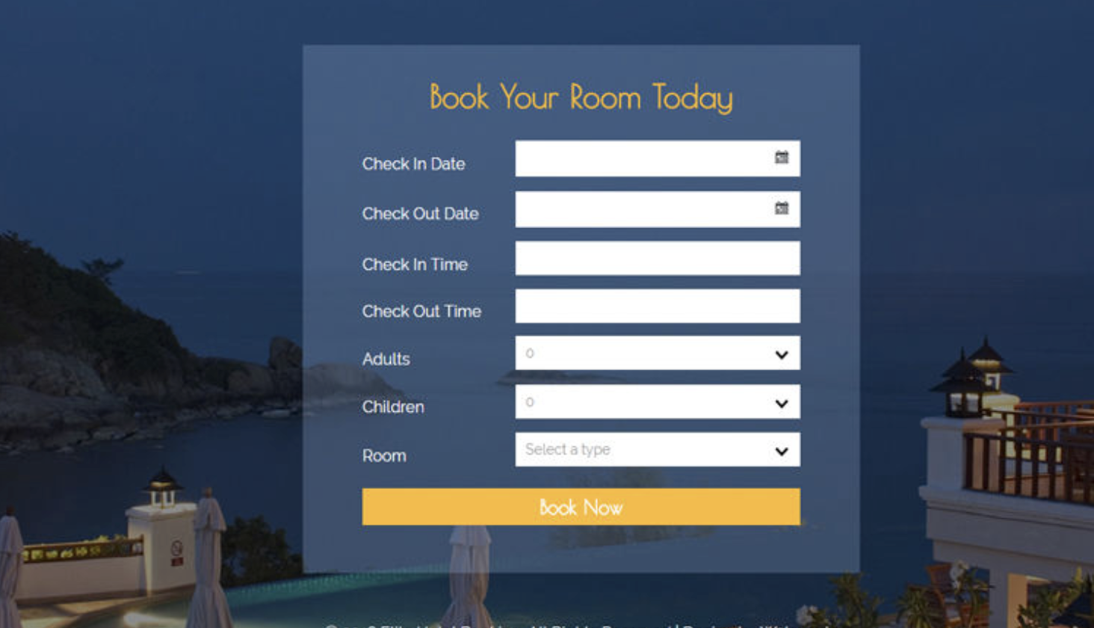
Online booking

Slide 13
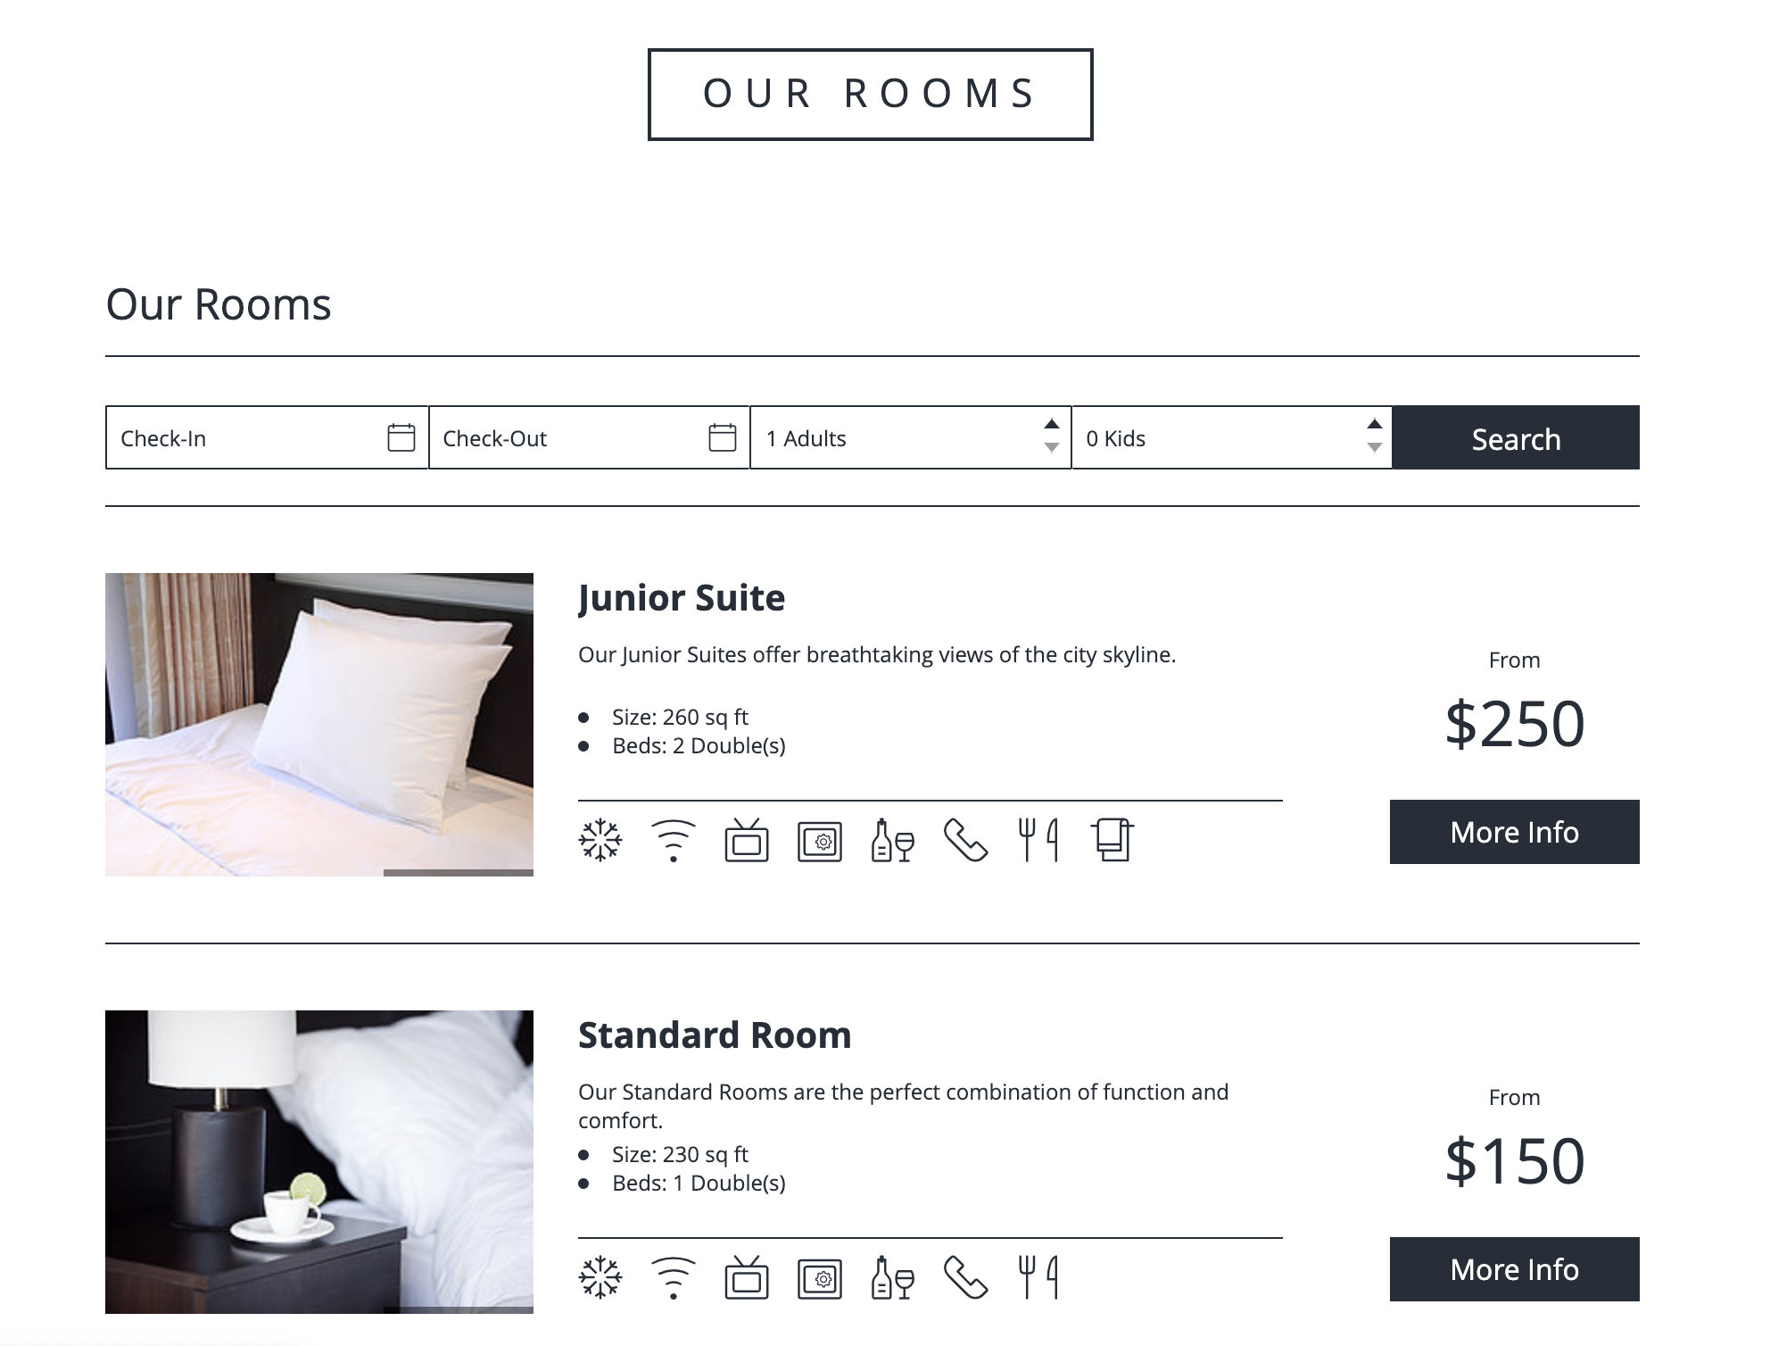

Slide 14
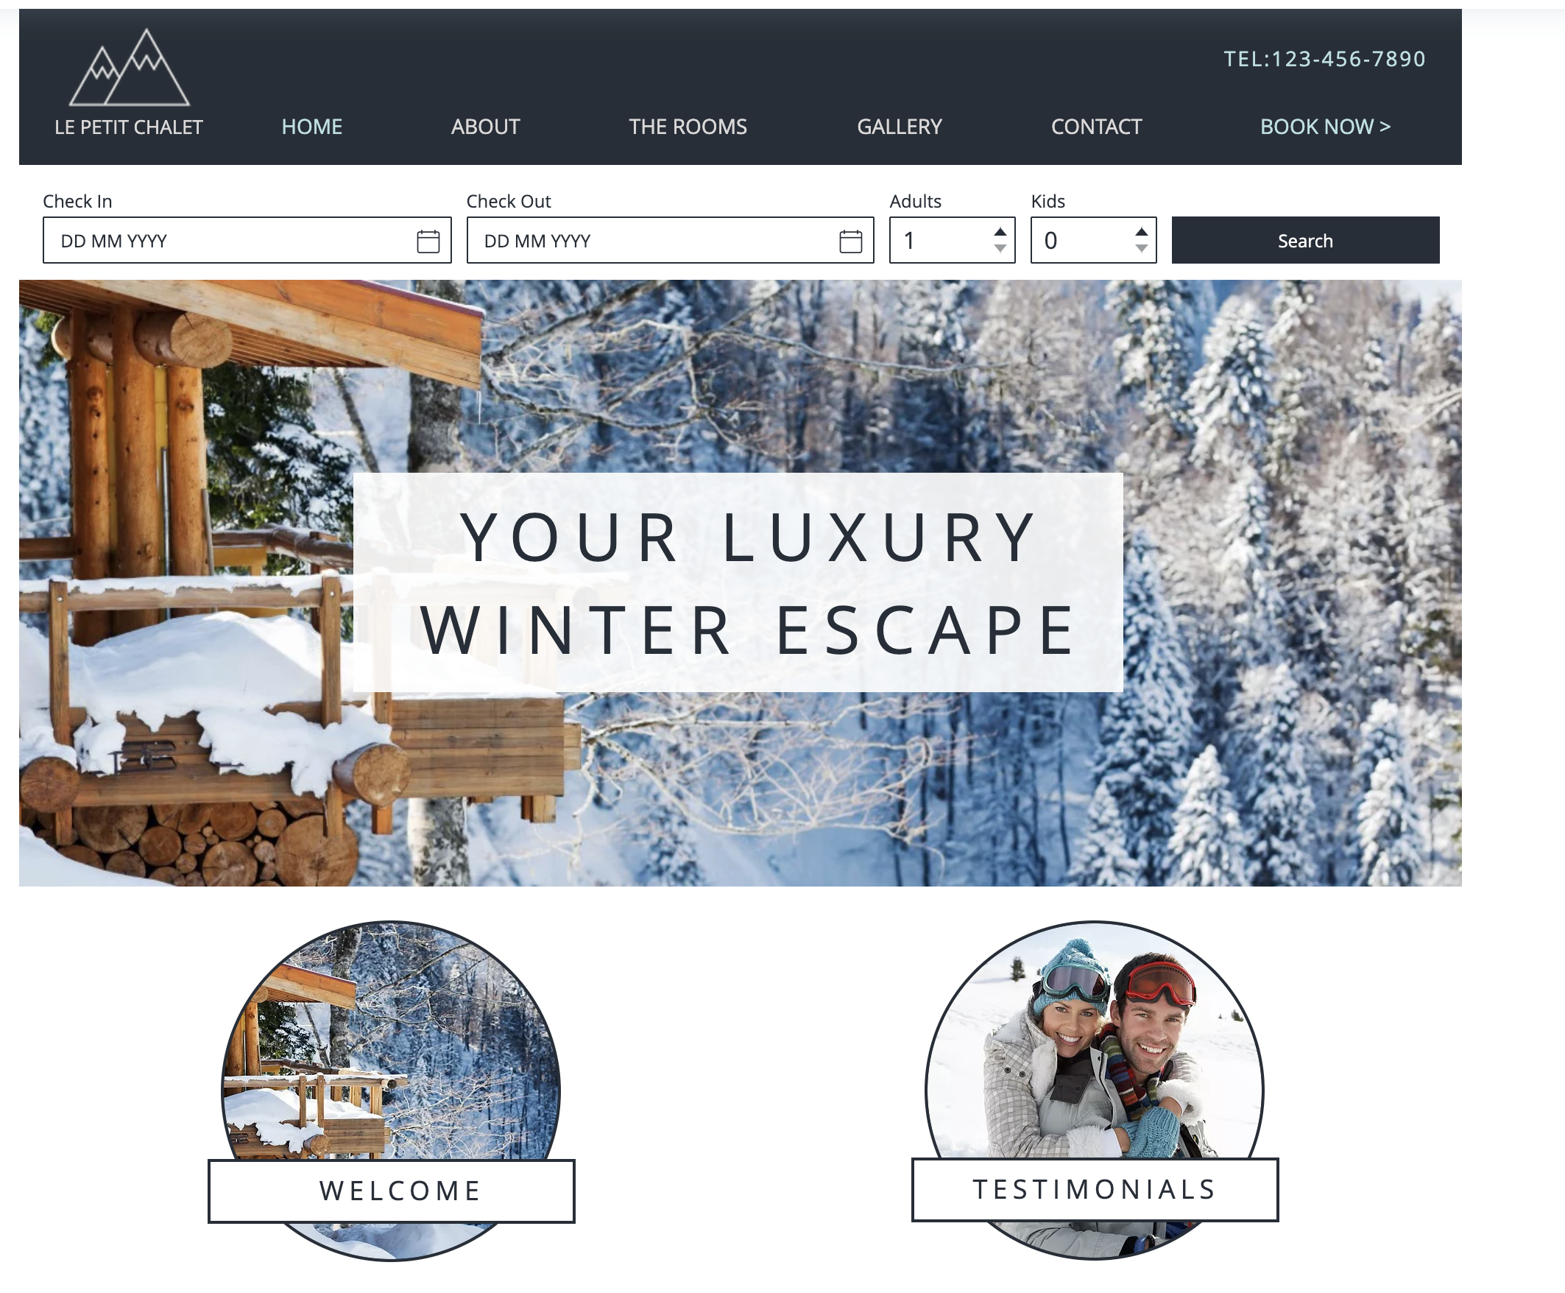
Attractive website

Slide 15
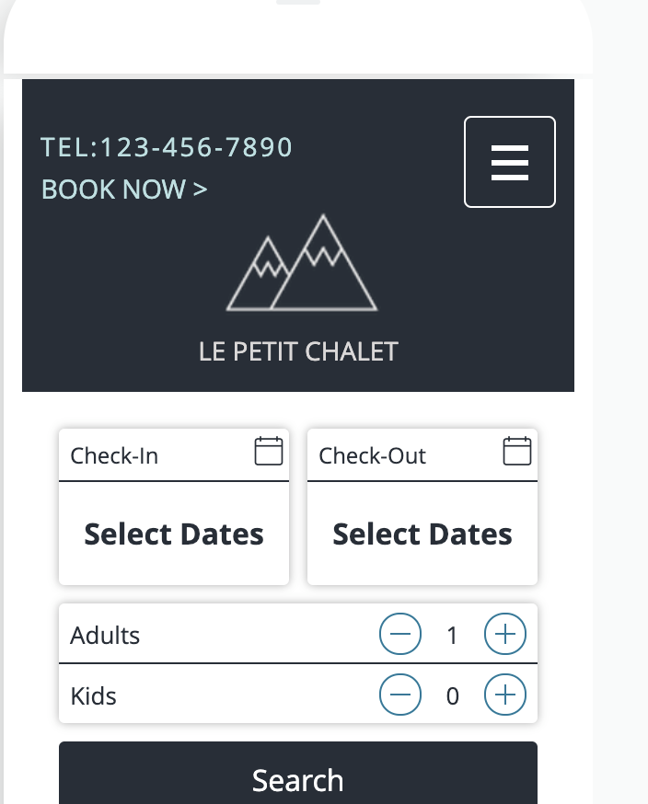
Mobile friendly

Slide 16
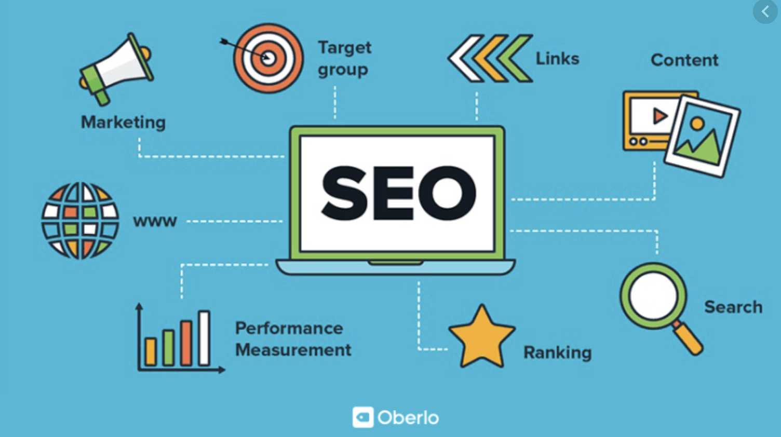
Notes:
Lots of free tools and cheap tools like Hashtag Jeff to help you
Strong online presence

Slide 17
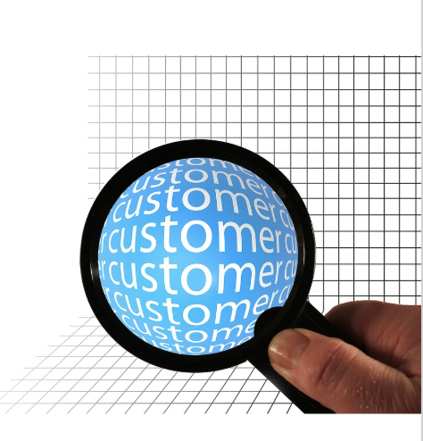
Social media
Importance of staying active on it
Engaging in conversation
Which channels to be on
How to engage with the CCCTA

Slide 18
Benefits of Using Social Media for Business
Increase awareness of your brand
Improve your search engine rankings (SEO)
Increase opportunity to reach your target audience
Receive feedback from your customers
Notes:
To create a better understanding of how to achieve positive results for your business, here are some of the potential benefits of being active on social media:
i. Increase awareness of your brand, service and/or product
Businesses that are active on social media can share content postings about their products and services that can be seen by an extended audience if shared by others online.
ii. Improve the search engine rankings of your brand
Social media posts and accounts are indexed by search engines and can help improve the rankings of your business online.
iii. Increase your opportunity to reach your target audience
There are paid advertising options through social media platforms such as Facebook and Twitter. These options allow you to target specific demographics and psychographics to reach your desired target audience for low cost compared to traditional media marketing.
iv. Receive feedback from customers
People use social media to share their opinions every day. As a potential customer, these opinions are open to public and can be viewed on Facebook, Twitter and Instagram before you’ve even experienced a brand’s good or service.
As a business, be prepared for both positive and negative feedback. There is an important opportunity in what you choose to do with the feedback being provided.

Slide 19
Potential Risks of Using Social Media for Business
It requires time and effort to do it right
You might get a negative review
You might not get much response/engagement with your posts
Not keeping your content current

Slide 20
Secrets of successful social accounts
CONSISTENT - no lapses in posting
QUALITY - great visual content
HIGHLY ENGAGED - active in conversations
CREATIVE - eye-catching and unique
Notes:
follow @instagramforbusiness
share a mix of photos of your business & the destination
provide a feel for the type of experience a guest will have with you
take photos while you are out and about
post consistently - even if its only 1x per week
edit your photos using tools such as Snapseed, VSCO or IG filters. Stick to using 1 or 2 to maintain tone

Slide 21
Stay active!
200 million Instagram users visit a business profile every day
Your customers look for social media icons on your website
Insert the icons that you know you can remain active on (even if it’s a few posts a month)
Instagram is a social media storefront
Avoid large gaps in posting content
Notes:
Your customers look for social media icons on your website
Insert the icons that you know you can remain active on (even if it’s a few posts a month)
Instagram is a social media storefront Customers browse a feed to find more. Sometimes users will look at this over your website gallery
Avoid large gaps in posting content this discredits your brand and your business

Slide 22
Engage in conversation
Reply back to users on posts
Engage with hashtags
Engage with geotags

Slide 23
Channels to be on:
Instagram
Visual platform
Showcase your business with a gallery of images and videos
Show seasonality
Anyone can do it with a smartphone (no professional images necessary)
Use permanent highlight reels with video and photos from a smartphone
Include a live IG feed in your website

Slide 24
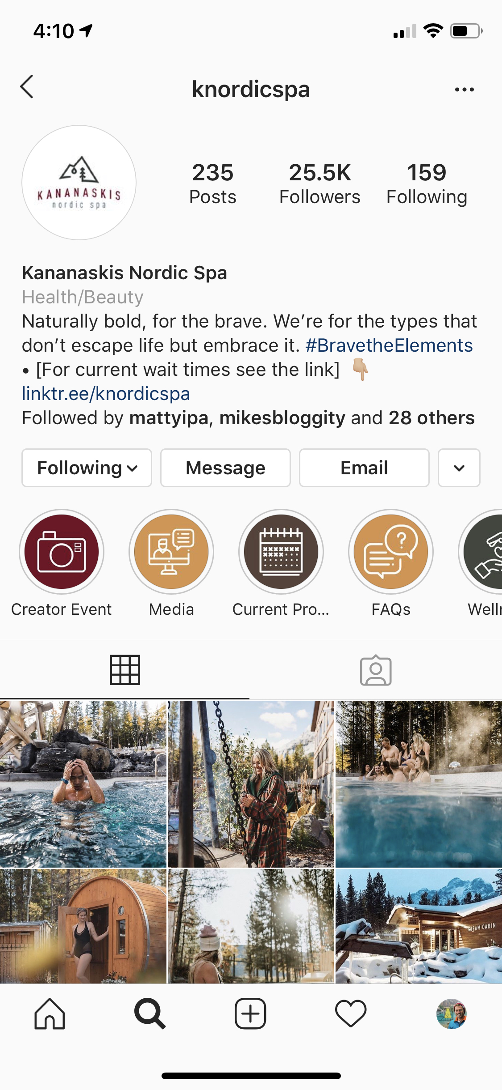
Show a journey
Create highlight icons to show a journey of your business

Slide 25
Facebook
A source of reviews/ratings
Visual with images + video
Easy to do paid advertising (Jonny can help get you started if you’re interested!)
Has users from all age demographics although is increasingly shifting to older demographics
Increase traffic to website

Slide 26
Twitter
Good for news sources
Not very visual
Ideal for emergency responses and messaging

Slide 27
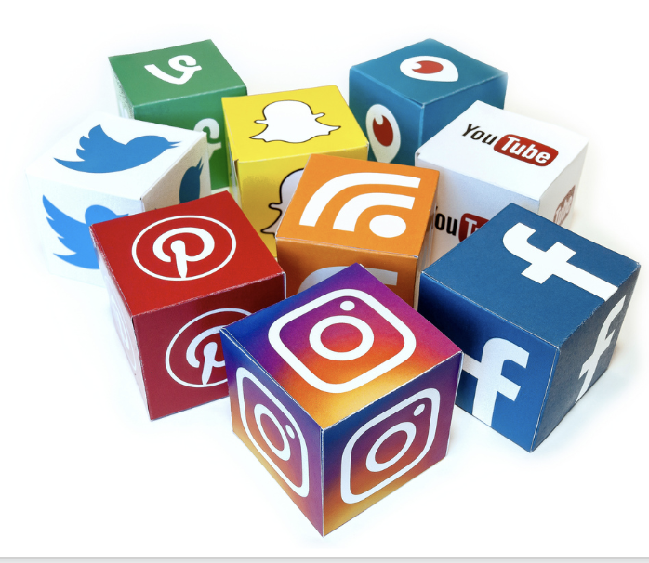
Engage with us!
Follow us on all channels
Instagram & Twitter: @carchicoa
Facebook: @CaribooChilcotinCoast
Tag your content:
#CCCLives #ExploreBC #ExploreCanada @carchicoa @hellobc @explorecanada
Tag us in all content, we will reshare and request rights via our UGC software!

Slide 28
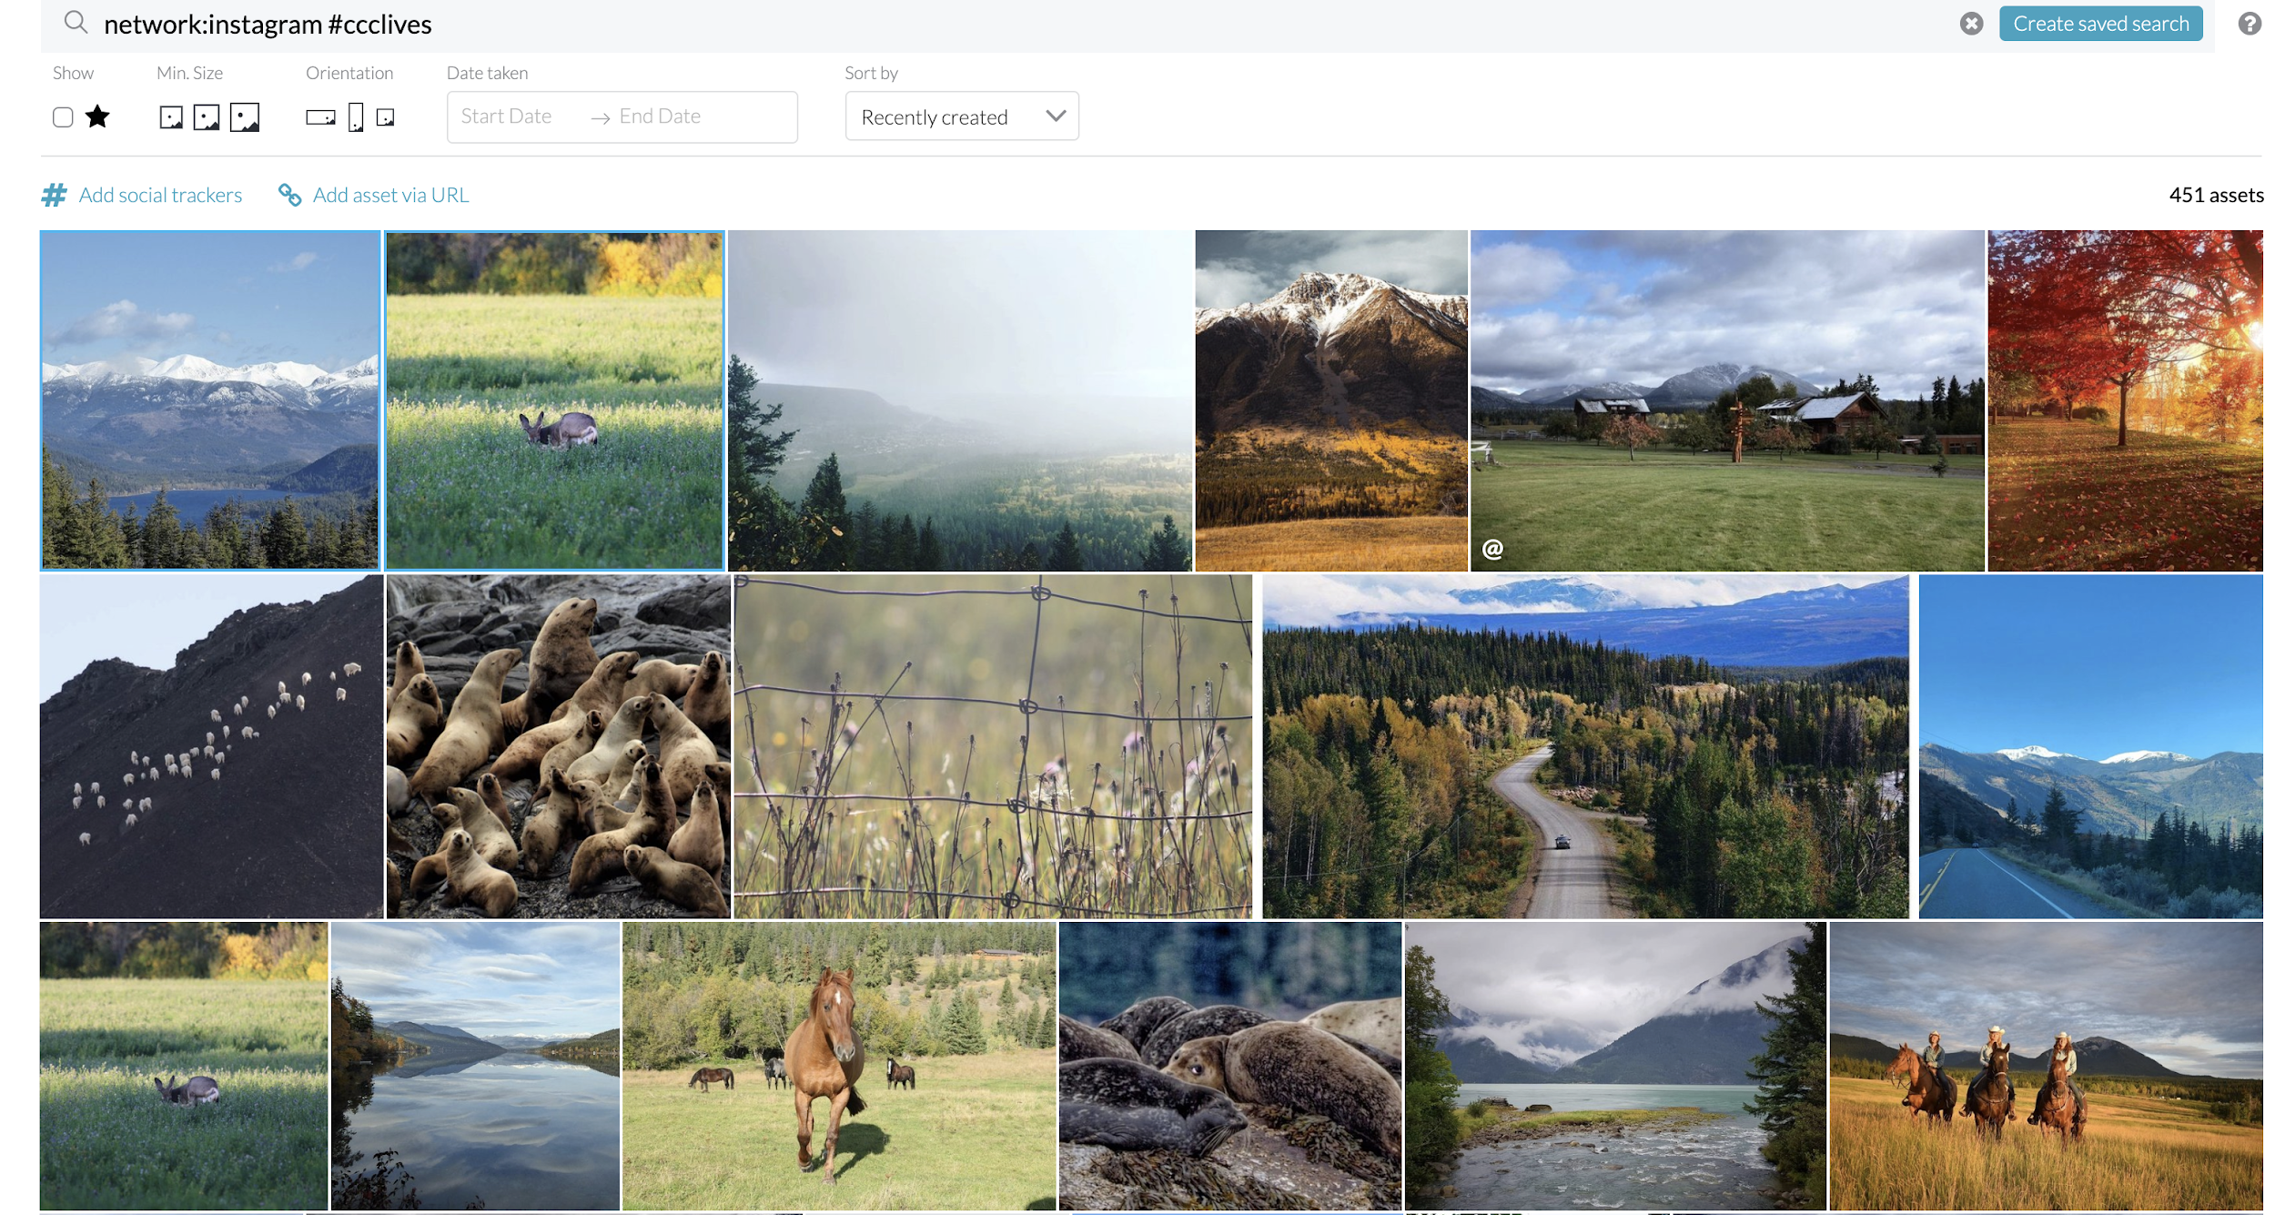
UGC

Slide 29
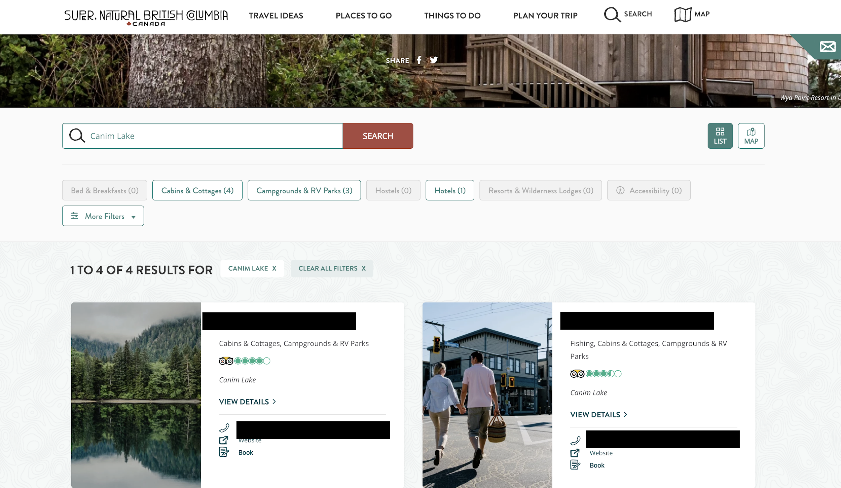
Trip Advisor
DBC website pulls TripAdvisor information to hellobc ‘Plan Your Trip’
Make sure your info is up to date, you reply to feedback and like social media, stay active

Slide 30
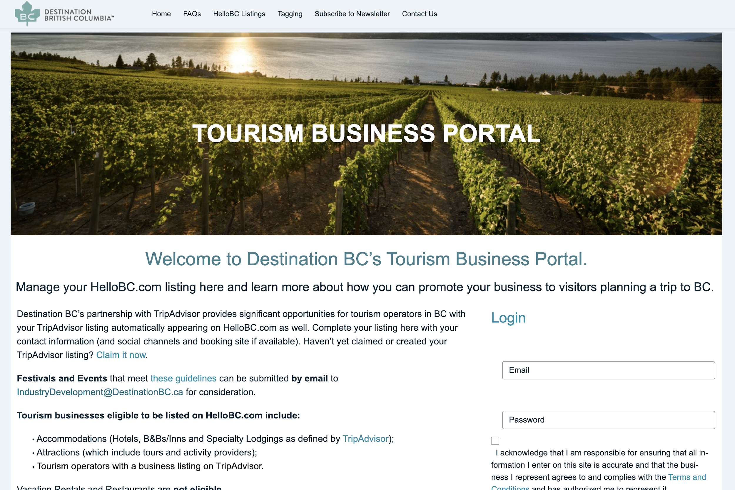
Manage your TripAdvisor listing!

Slide 31
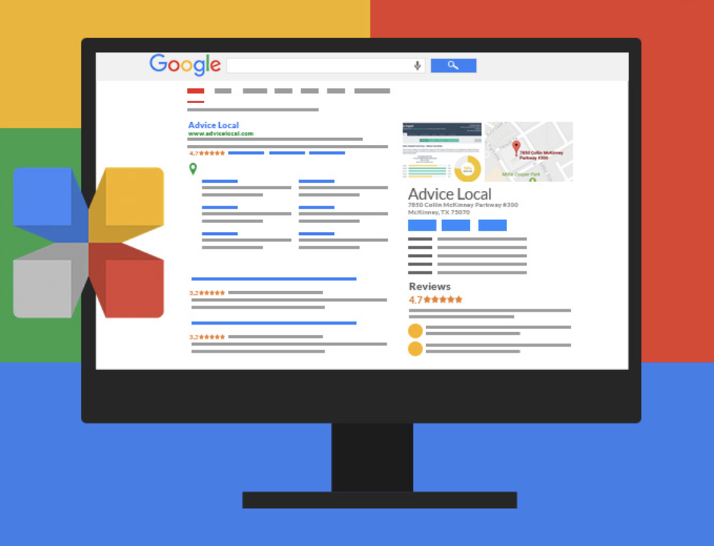
Google
My
Business
Free & easy to use online tool to manage a business presence across Google including Search and Maps
Your free digital business card
If you don’t claim it, anyone can add edits to it
The CCCTA team is authorized to verify your Google My Business listing
The team will come out and take 360 degree imagery to upload to your listing
They will update and optimize your listing
Email google@landwithoutlimits.com to inquire about claiming/optimizing your listing

Slide 32
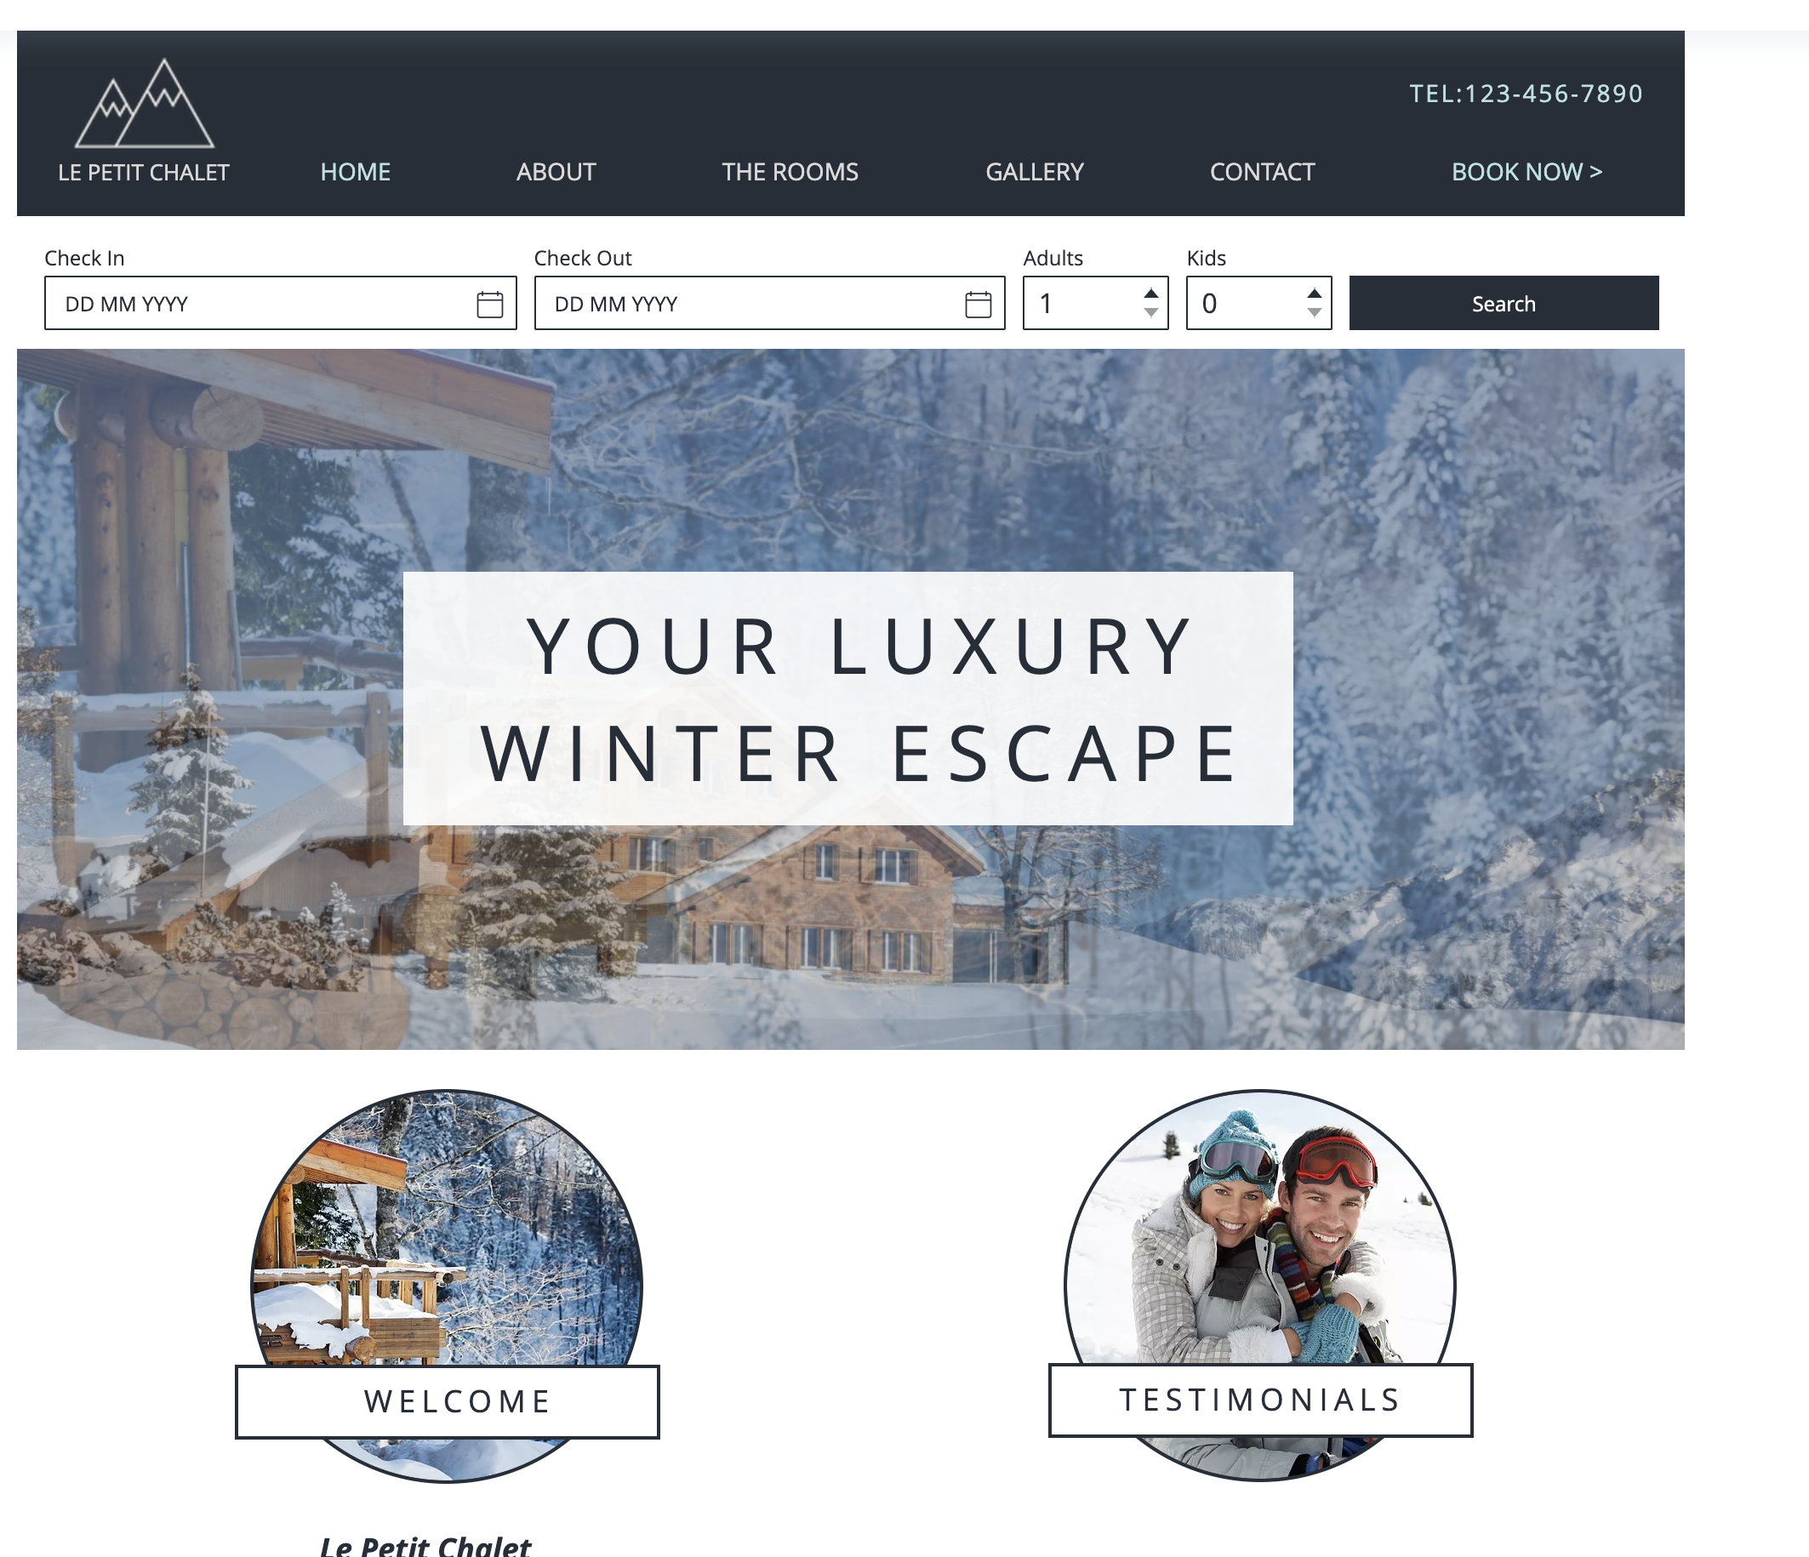
Intro to making a website with Wix

